Slide 1
Understanding Employee Attrition A Data-Driven Approach to Reduce Turnover
Leveraging HR Analytics to Drive Strategic Decisions and Improve Retention at Company

Slide 2
Understanding Employee Attrition at Company
Good Morning,
My Role in this Project will be HR Analyst.
Today, we're addressing a significant challenge at Company: high employee turnover. It's more than just a number; it's a pressing issue that demands our attention.

Slide 3
Impact of High Attrition
Before we dive into the details, let's consider the broader impact of this issue on our organization.
Impact on Productivity
When experienced employees leave, it disrupts our workflow and affects our ability to deliver results efficiently.

Slide 4
Impact on Morale
Constant turnover can create a sense of instability and lower morale among our remaining staff.
Impact on Profitability
From recruitment costs to the loss of valuable expertise, high attrition can have a significant financial impact on our company.

Slide 5
The Urgency to Address the Issue
Given these challenges, it's imperative that we take proactive steps to understand the root causes of attrition and implement strategies to improve retention.

Slide 6
My Role As a HR Analyst
I have to get data and start the analysis on it .
I’m using Python Programming Language and Pandas Library for the Data Preprocessing on it .
I will show also EDA on this Data given by the company .
And After the successful Analysis on it I will make a Dashboard with using power BI.

Slide 7
Data Preprocessing on Pandas
1. Loading Data:
The first step is to load your data into a Pandas DataFrame. This can be done by reading data from various sources such as CSV files, Excel files, databases, or web APIs using Pandas' read_csv(), read_excel(), read_sql(), or read_json() functions, among others.
2. Handling Missing Values:
Missing values are common in real-world datasets and can adversely affect the analysis. Pandas provides methods like isnull(), notnull(), dropna(), and fillna() to detect and handle missing values by either removing rows or filling them with appropriate values.
3. Data Cleaning:
Data cleaning involves handling inconsistencies, errors, and outliers in the dataset. This may include correcting data types, removing duplicate records, and standardizing data formats. Pandas provides functions like astype(), drop_duplicates(), and various string manipulation methods for cleaning text data.
4. Data Transformation:
Data transformation involves converting the structure or format of the data to make it suitable for analysis. This includes tasks such as feature scaling, encoding categorical variables, and creating new features. Pandas provides functions like map(), apply(), get_dummies(), and cut() for data transformation tasks.

Slide 8
5. Data Aggregation and Grouping:
Aggregating and grouping data allows you to summarize and analyze data at different levels of granularity. Pandas' groupby() function is commonly used for this purpose, along with aggregation functions like sum(), mean(), count(), etc.
6. Data Normalization:
Normalizing data involves scaling numerical features to a standard range to ensure fair comparison between variables with different units and scales. Pandas provides functions like MinMaxScaler and StandardScaler from the sklearn.preprocessing module for data normalization.
7. Handling Outliers:
Outliers are extreme values that can skew statistical analysis. Pandas provides various methods for detecting and handling outliers, such as z-score calculation (scipy.stats.zscore) and visualization techniques like box plots (matplotlib or seaborn).
8. Feature Engineering:
Feature engineering involves creating new features from existing ones to improve model performance. This may include extracting information from date-time variables, binning numerical features, or combining categorical variables. Pandas provides functions and methods for feature extraction, manipulation, and combination.
9. Data Visualization:
Although not strictly part of data preprocessing, data visualization plays a crucial role in understanding the data distribution, relationships between variables, and identifying patterns or trends. Pandas integrates seamlessly with libraries like matplotlib and seaborn for data visualization.

Slide 9
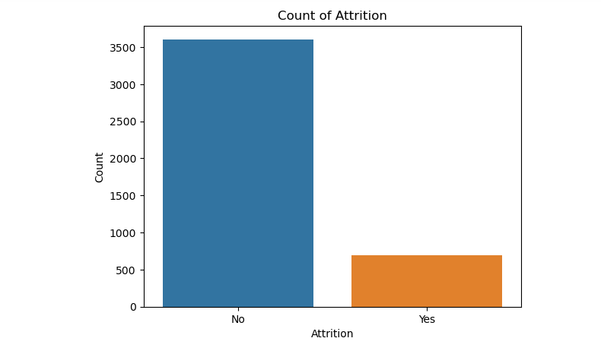
Data Visualization
Data visualization by Matplotlib

Slide 10
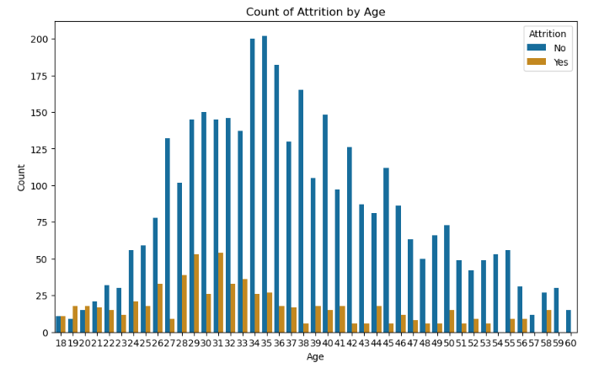
Attrition w.r.t Age
We can see with this graph the attrition among age 29 - 34 around having more attrition .

Slide 11
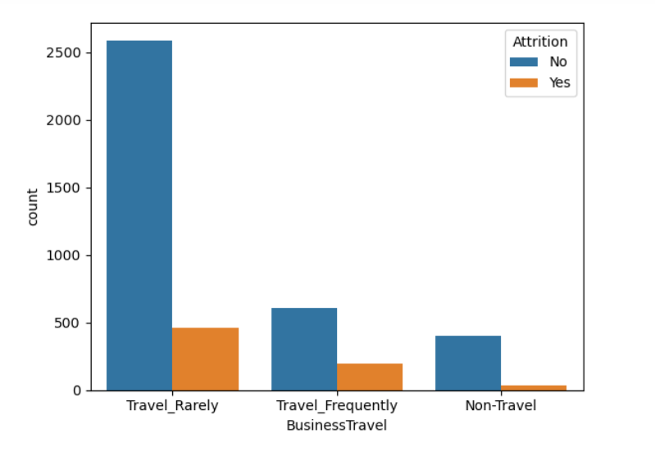
Attrition w.r.t Business Travel
Here we can see with this graph that Employees who travel – rarely having high attrition rate than who travel frequently or who not travel.

Slide 12
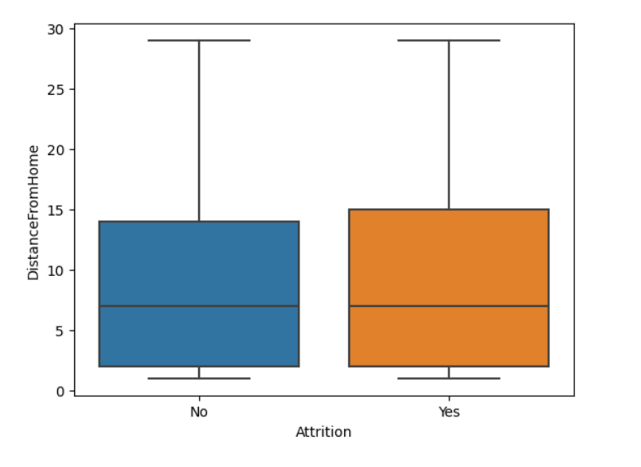
Attrition w.r.t Distance from home
High attrition rates are observed among employees residing far from the workplace, highlighting the importance of tailored retention strategies for geographically distant workers.

Slide 13
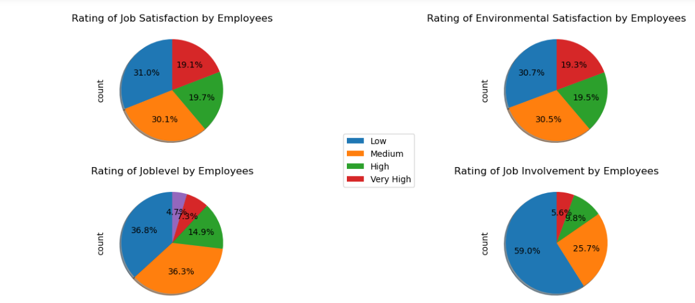
Analyzing the attrition w.r.t Rating Features
Attrition due to these ratings we can see that job satisfaction is less in more employees. Attrition due to Environment satisfaction is vary because the Environment satisfaction between employees is very less than those who really satisfied with environment of the company. The attrition due to job level of employees is vary between their responsiblities in the job . Here in this last pie chart we can see that the job involvement between employees is very less a very few employees are involve in their job .

Slide 14
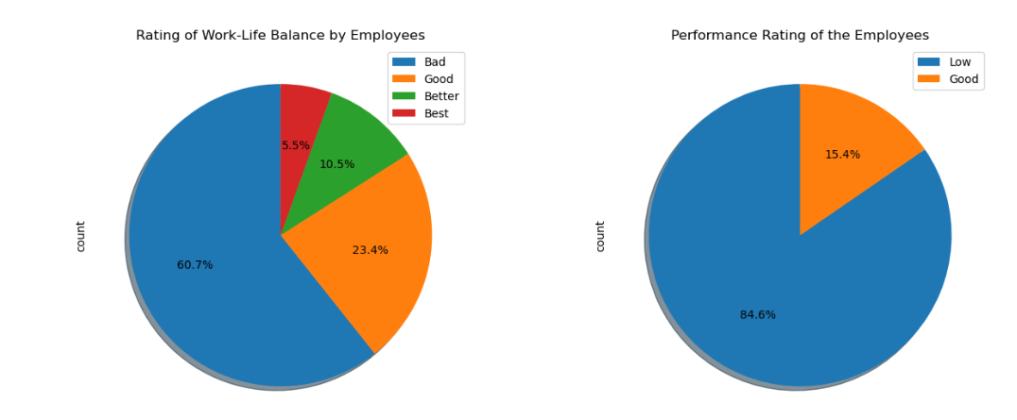
Analyzing by work-life balance and Performance Rating
Here we can see rating of work life balance is very bad by the employees due to this pie chart we can see that the large number of employees aren’t having work life balance which is the one of the reason of Attrition in employees . And on the other hand the performance rating of employees is very low due to this Attrition rate is very high .

Slide 15
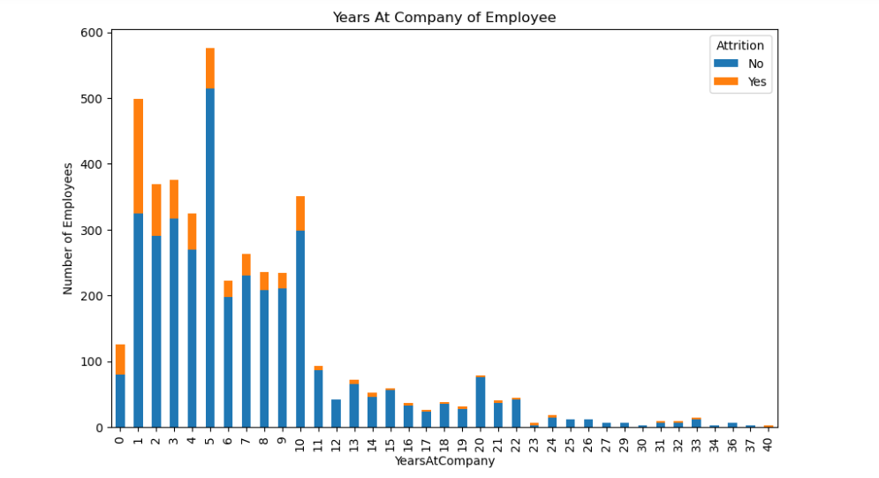
Attrition w.r.t Years at company
Here we can see that the attrition between fresher’s candidates is higher than other company should give them a chance that they should not change their job very frequently .

Slide 16
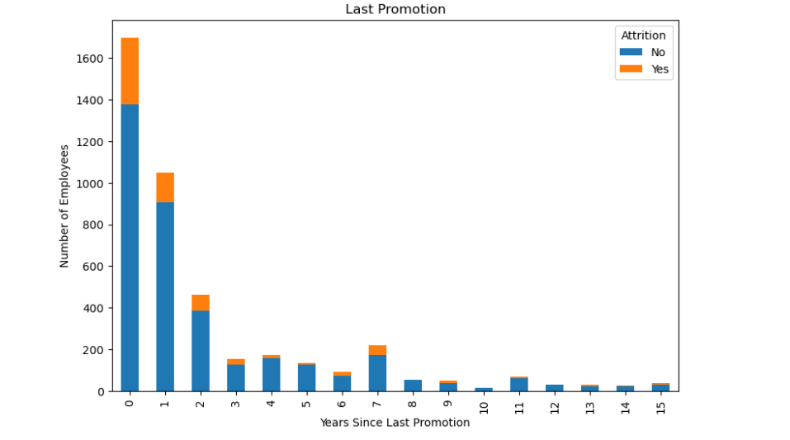
Attrition w.r.t Last Promotion
Here we can see that attrition is very high in the first year .

Slide 17
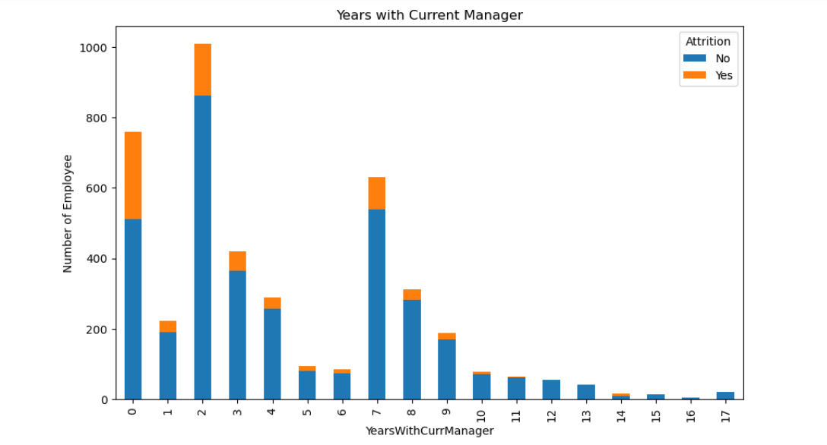
Attrition w.r.t Years with Current Manager
Here we can see Attrition in employees is very high who have joined recently in this company due to interaction with their manager . Managers should know how to interact with their employees due to this reason the attrition rate is very high.

Slide 18
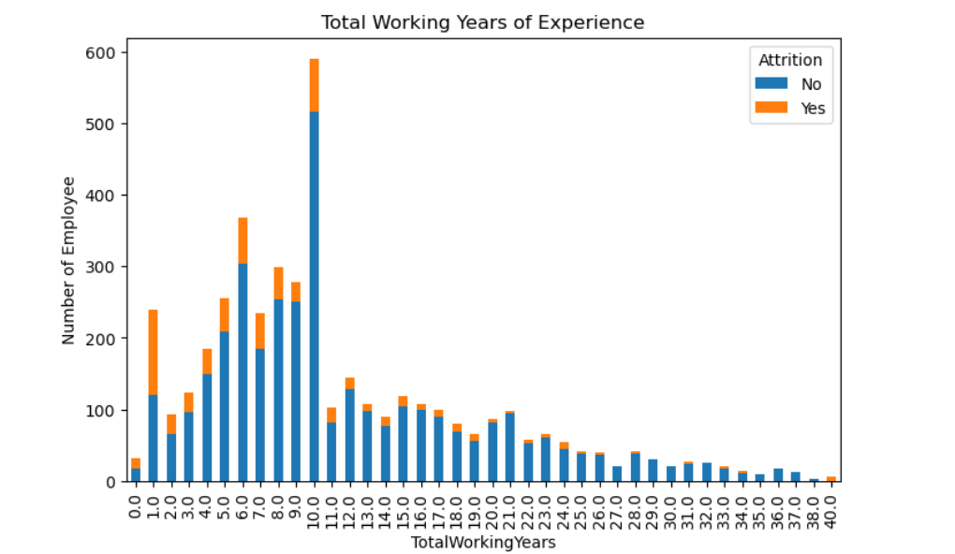
Attrition w.r.t Total working years
Here we can see that the Attrition rate is very high in the fresher’s the company should give them a chance to reduce this attrition rate .

Slide 19
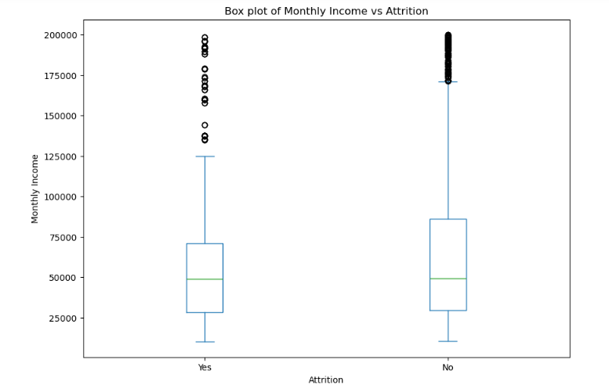
Attrition w.r.t Monthly Income
Here is the Attrition rate by the monthly income of employees .

Slide 20
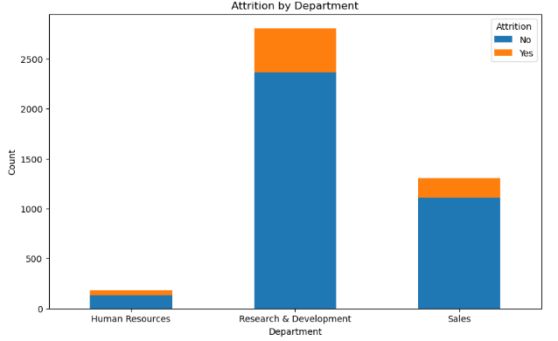
Attrition w.r.t Department
Here we can see attrition rate is very high in research & development department but we can see attrition rate is among all these departments.

Slide 21
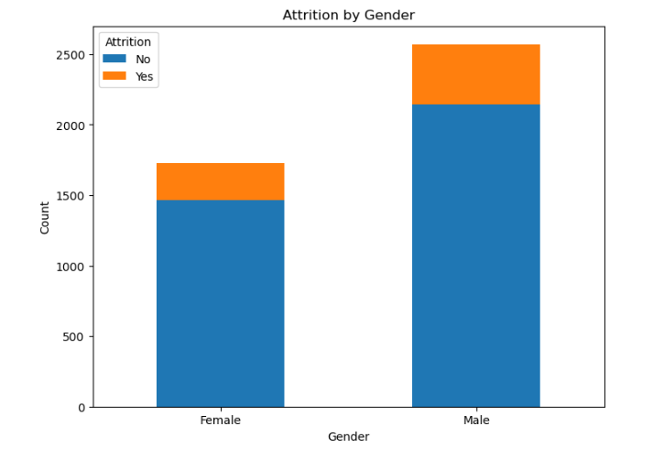
Attrition by Gender
We can see that the attrition among male employees is higher than female employees.

Slide 22
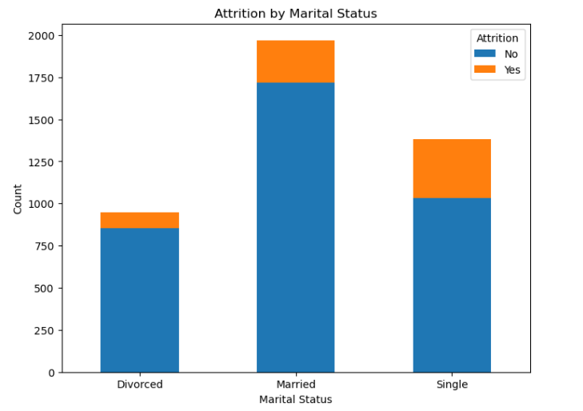
Attrition by Marital Status
Here we can see that the single employees leaving the company rate is very higher than the other

Slide 23
Attrition by Marital Status
Here we can see that the single employees leaving the company rate is very higher than the other divorced and married people.

Slide 24
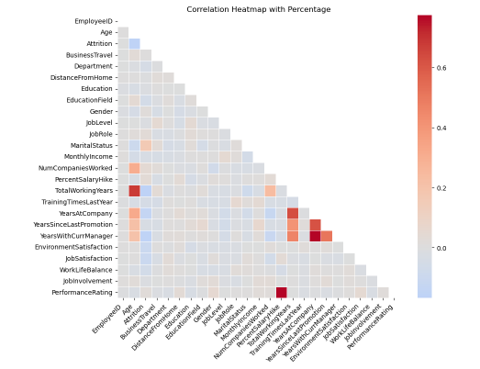
Here is the Correlation Between Columns

Slide 25
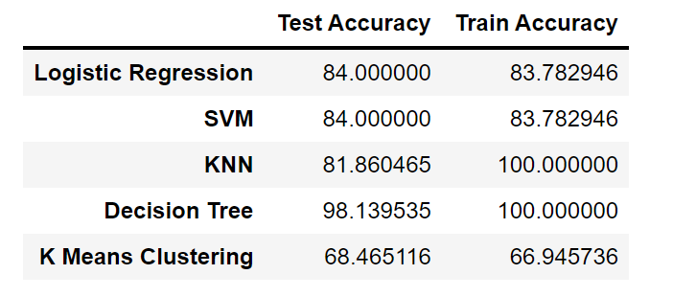
Here is the Train and Test Accuracy with Supervised Machine learning
Here we can see the all models of supervised machine learning .
We can see that the KNN and Decision tree algorithm is over-fitting the train accuracy and the accuracy of logistic regression is perfect fit model for prediction .

Slide 26
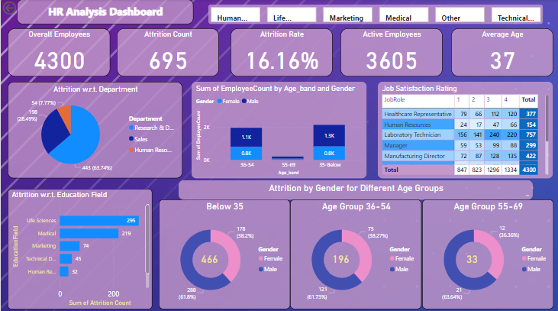
Dashboard on Employee Attrition

Slide 27
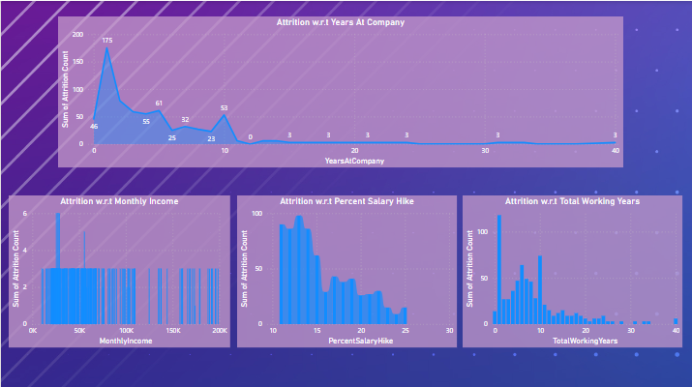
This is the dashboard of the HR Analtics Project

Slide 28

Click Preview button to view this video

